Slide 1

Reproducibility as a Community Effort Lessons from the
Madagascar Project
Sergey Fomel
Jackson School of Geosciences
The University of Texas at Austin
12/13/2012
ICERM Reproducibility in Computational and Experimental Mathematics

Slide 2
What is Science?

Slide 3

What is Science?
Science is the systematic enterprise of gathering knowledge about the universe and organizing and condensing that knowledge into testable laws and theories. The success and credibility of science are anchored in the willingness of scientists to expose their ideas and results to independent testing and replication by other scientists. This requires the complete and open exchange of data, procedures and materials.

Slide 4
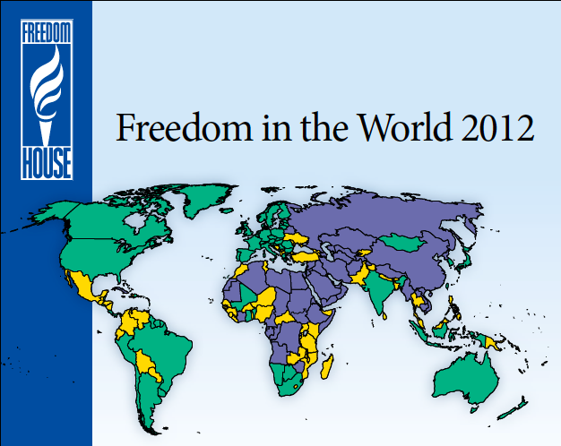

Slide 5
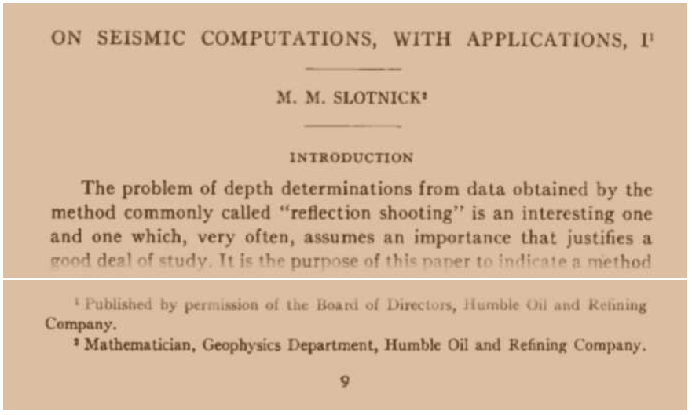
Second Paper Published in Geophysics

Slide 6
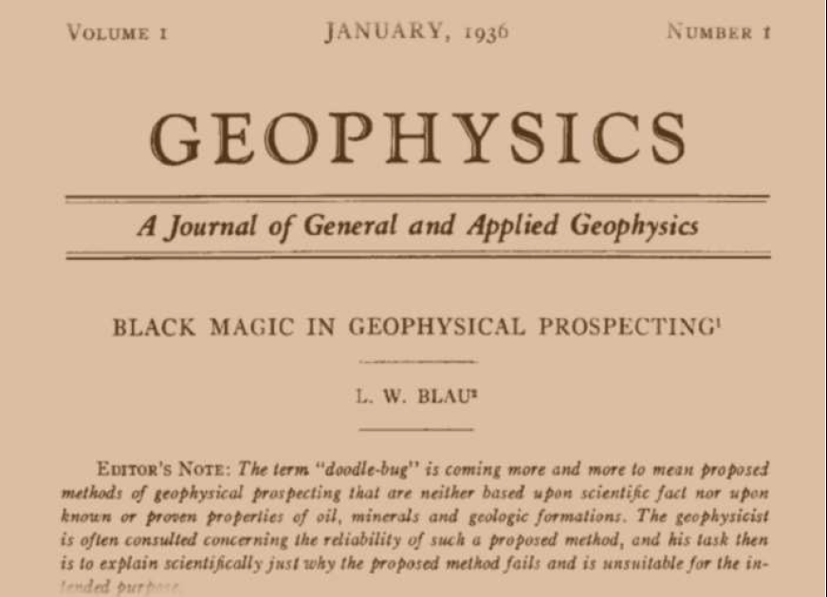
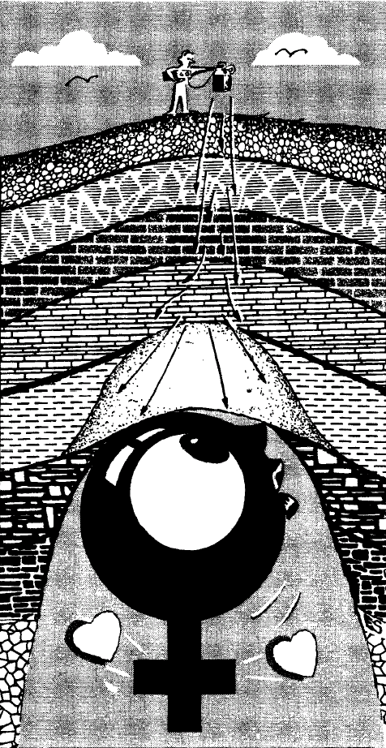
First Paper Published in Geophysics

Slide 7
(Hale, 1984)

Slide 8
(Hale, 1984)

Slide 9
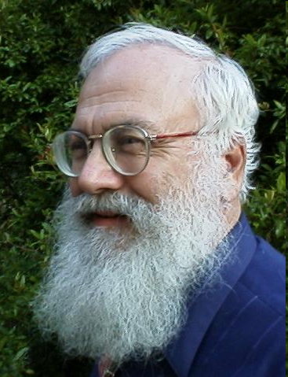
Claerbout’s principle
“An article about computational science in a scientific publication is not the scholarship itself, it is merely advertising of the scholarship. The actual scholarship is the complete software development environment and the complete set of instructions which generated the figures.”
(Buckheit and Donoho, 1995)

Slide 10
“It is a big chore for one researcher to reproduce the analysis and computational results of another […] I discovered that this problem has a simple technological solution: illustrations (figures) in a technical document are made by programs and command scripts that along with required data should be linked to the document itself […] This is hardly any extra work for the author, but it makes the document much more valuable to readers who possess the document in electronic form because they are able to track down the computations that lead to the illustrations.” (Claerbout, 1991)

Slide 11
http://www.ahay.org/

Slide 12

In a Nutshell, Madagascar...
... has had 8,484 commits made by 61 contributors
representing 485,143 lines of code
... is mostly written in C
with an average number of source code comments
... has a well established, mature codebase
maintained by a large development team
with increasing year-over-year commits
... took an estimated 129 years of effort (COCOMO)
starting with its first commit in May, 2003
ending with its most recent commit 3 days ago

Slide 13
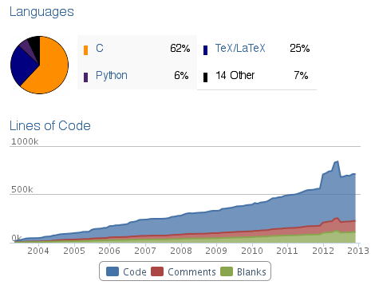

Slide 14
Contributors
Tariq Alkhalifah, Vladimir Bashkardin,
Jules Browaeys, William Burnett, Cody Brown,
Yihua Cai, Maria Cameron, Lorenzo Casasanta, Yangkang Chen, Zhonghuan Chen, Jiubing Cheng, Joseph Dellinger, Esteban Diaz, Sergey Fomel,
Jeff Godwin, Gilles Hennenfent, Jingwei Hu,
Trevor Irons,Jim Jennings, Jun Ji, Long Jin,
Parvaneh Karimi, Roman Kazinnik, Alexander Klokov, Siwei Li, Guochang Liu, Yang Liu, Xuxin Ma,
Doug McCowan, Henryk Modzelewski, Jack Poulson, James Rickett, Sean Ross-Ross, Colin Russell, Christos Saragiotis, Paul Sava, Karl Schleicher, Jeffrey Shragge, Eduardo Filpo Silva, Xiaolei Song, Yanadet Sripanich, Junzhe Sun, William Symes,
Ioan Vlad, Robin Weiss, Jia Yan, Lexing Ying

Slide 15
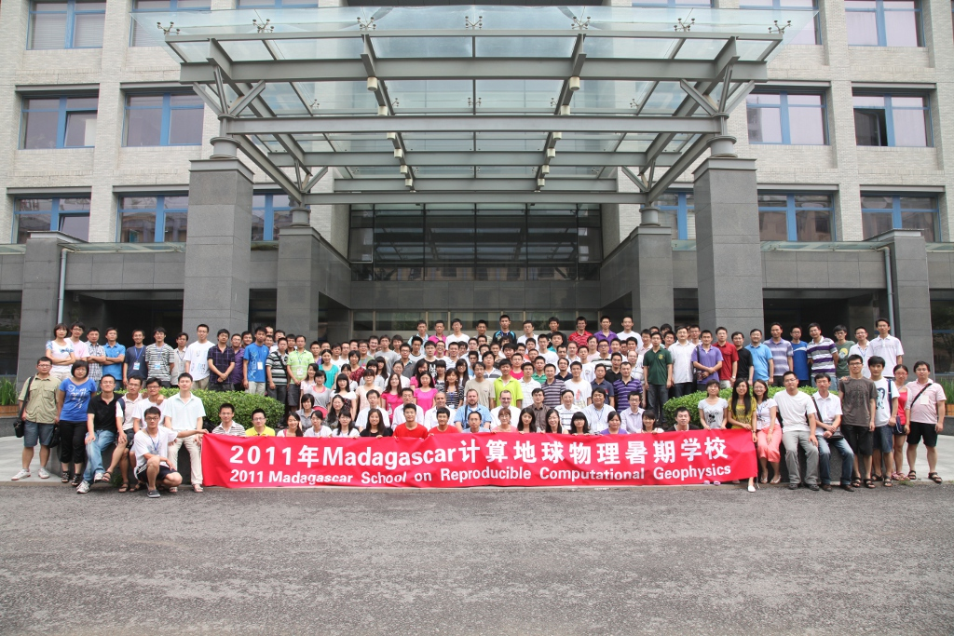

Slide 16
Reproducible Research: Lessons from Madagascar
Reproducibility is not the goal
The principal beneficiary is the author
Each computation is a test
Reproducibility requires maintenance
Maintenance requires an open community
http://www.ahay.org

